Slide 1
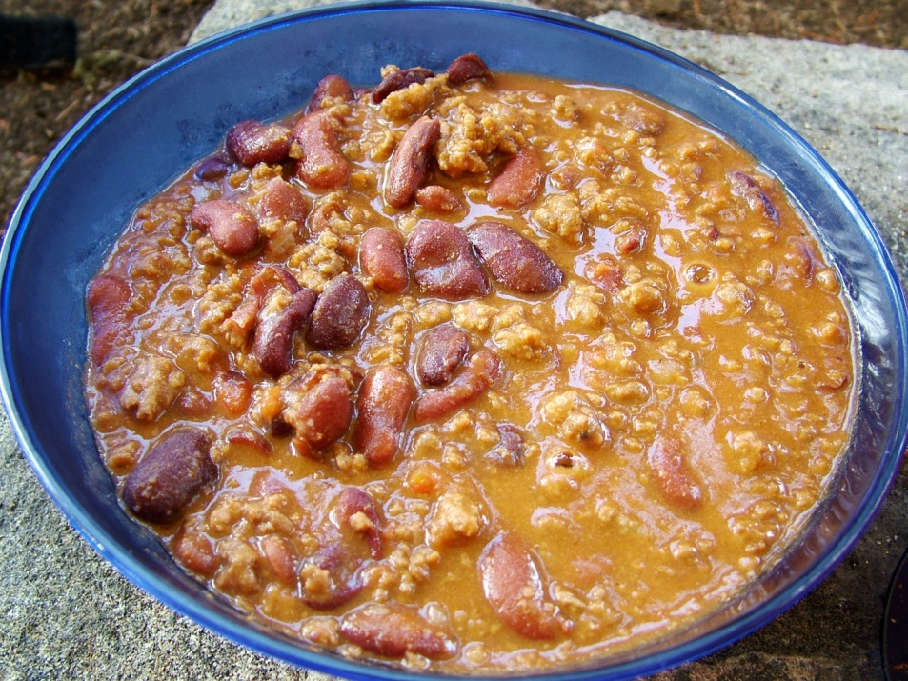
Backpacking Meals Made Simple
Terry McKibben
BSA Troop 344/9344
Pemberville, OH
troop344leaders@gmail.com

Slide 2
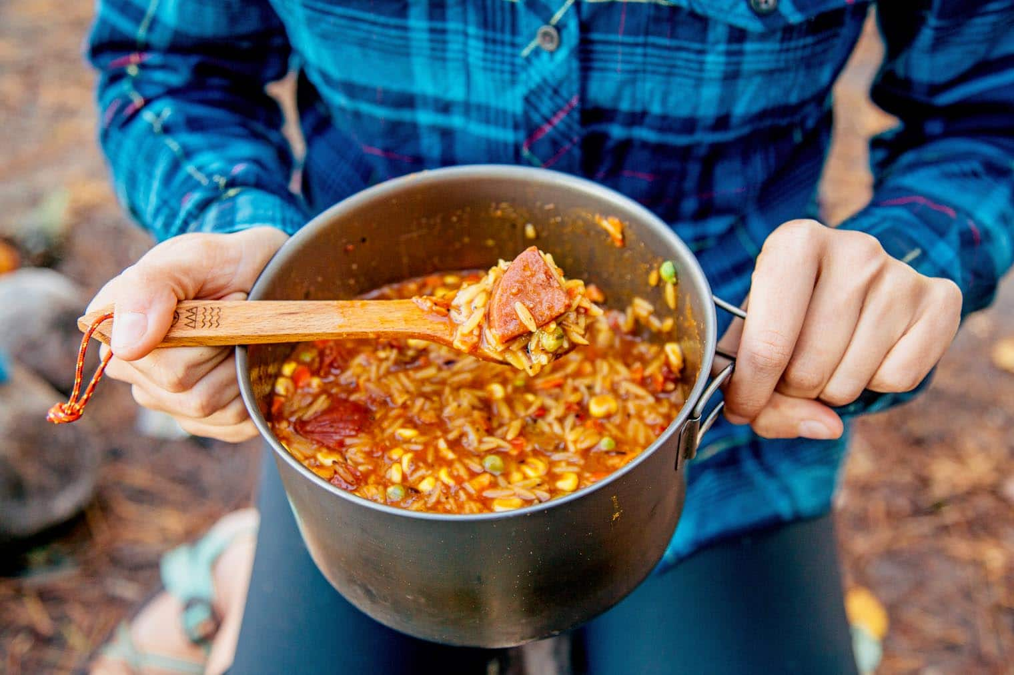
Backpacking Meals Made Simple
Backpacking food does not need to taste like cardboard.
You can eat delicious meals in the backcountry without too much effort and you can usually do it in ONE PAN!
Making your own backpacking meals is a great option compared to buying expensive freeze-dried or dehydrated meals.
Many backpacking and hiking recipes consist of less expensive, basic foods that can be found at most grocery stores, such as dried milk, rice, or pasta.
Many specialty items can be found at online stores.

Slide 3
Prepackaged vs. Home Dehydrated Meals
When planning your own high adventure trip to a wilderness area, the three major expenses are usually airfare, van rental, and food.
With the first two, you are limited on how much you can save.
By checking different rental agencies and airlines and adjusting your departure dates you can save some money.
You can guarantee immediate and substantial saving in the cost of food by dehydrating your own meals.

Slide 4
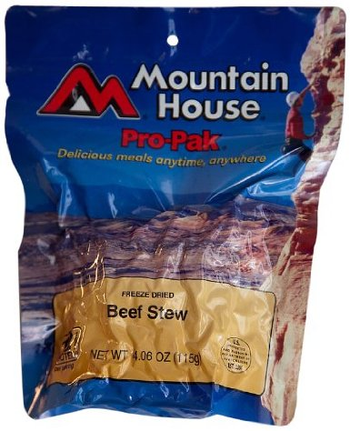
Prepackaged vs. Home Dehydrated Meals
At $8 - $9 per meal average for a commercial dehydrated meal, that comes out to at least $96 for one dinner (not counting dessert) for a crew of 12.
This is assuming that one package which averages 600 calories is enough for an individual.
Backpackers will burn somewhere between 3500 to more than 5000 calories per day depending upon their size.
Beef Stew $7.04
If your crew is on the trail for 7 days (6 nights) the total cost just for dinners is a minimum of $576.

Slide 5
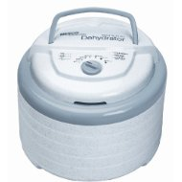
Prepackaged vs. Home Dehydrated Meals
By dehydrating your own meals and purchasing additional ingredients at a local grocery store, you can easily cut this cost by more than two thirds.
For under $70 you can obtain everything you need to begin the process of dehydration.
Nesco 600-Watt Food
Dehydrator $68.47
In other words, after just two evening meals you will have saved more than enough money to pay for the dehydrator and add-ons.

Slide 6
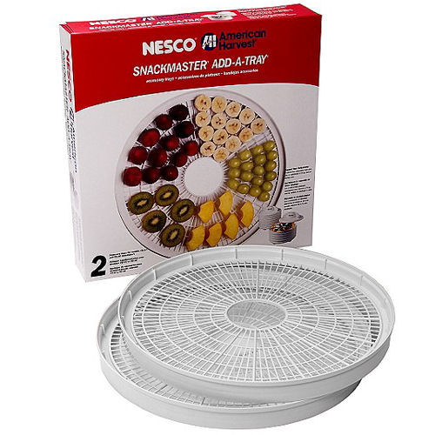
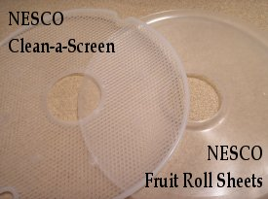
Prepackaged vs. Home Dehydrated Meals
Shorten the total time needed to dehydrate by one third by adding the following extras:
Nesco LT-2SG Add-A-Tray, Set of 2, $13.99
Nesco LSS-2-6 Fruit Roll Sheets, Set of 2, $14.53
Nesco LM-2-6 Clean-A-Screen Tray, Set of 2, $8.15
Additional Clean-A Screen Trays can shorten your total dehydrating time even more.
All of the above prices were obtained from Amazon.com.

Slide 7
Prepackaged vs. Home Dehydrated Meals
Additional savings for the rest of the meals reduce the cost of the trip for everyone.
The savings are even more in subsequent years because you have already purchased the equipment.
We estimate that we save our Scouts at least $50 each on the cost of a high adventure trip by preparing all of our own meals.
Our trips usually have a minimum of 20 participants resulting in savings of over $1000.

Slide 8
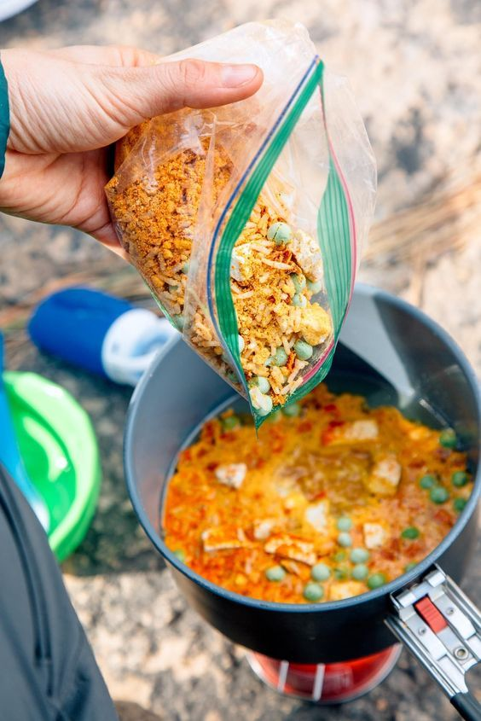
Prepackaged vs. Home Dehydrated Meals
Dehydrating your own food also gives you greater flexibility in your menu.
No longer are you limited in the choice of meals to those offered by commercial companies.
You will also realize some efficiency in packaging.
Imagine 12 empty packets after a meal is over versus two or three Ziploc baggies.
Our Scouts will testify that the meals we prepare in the backcountry are very satisfying, filling, and taste great.
We really do eat better than the average backpacker for a lot less.

Slide 9
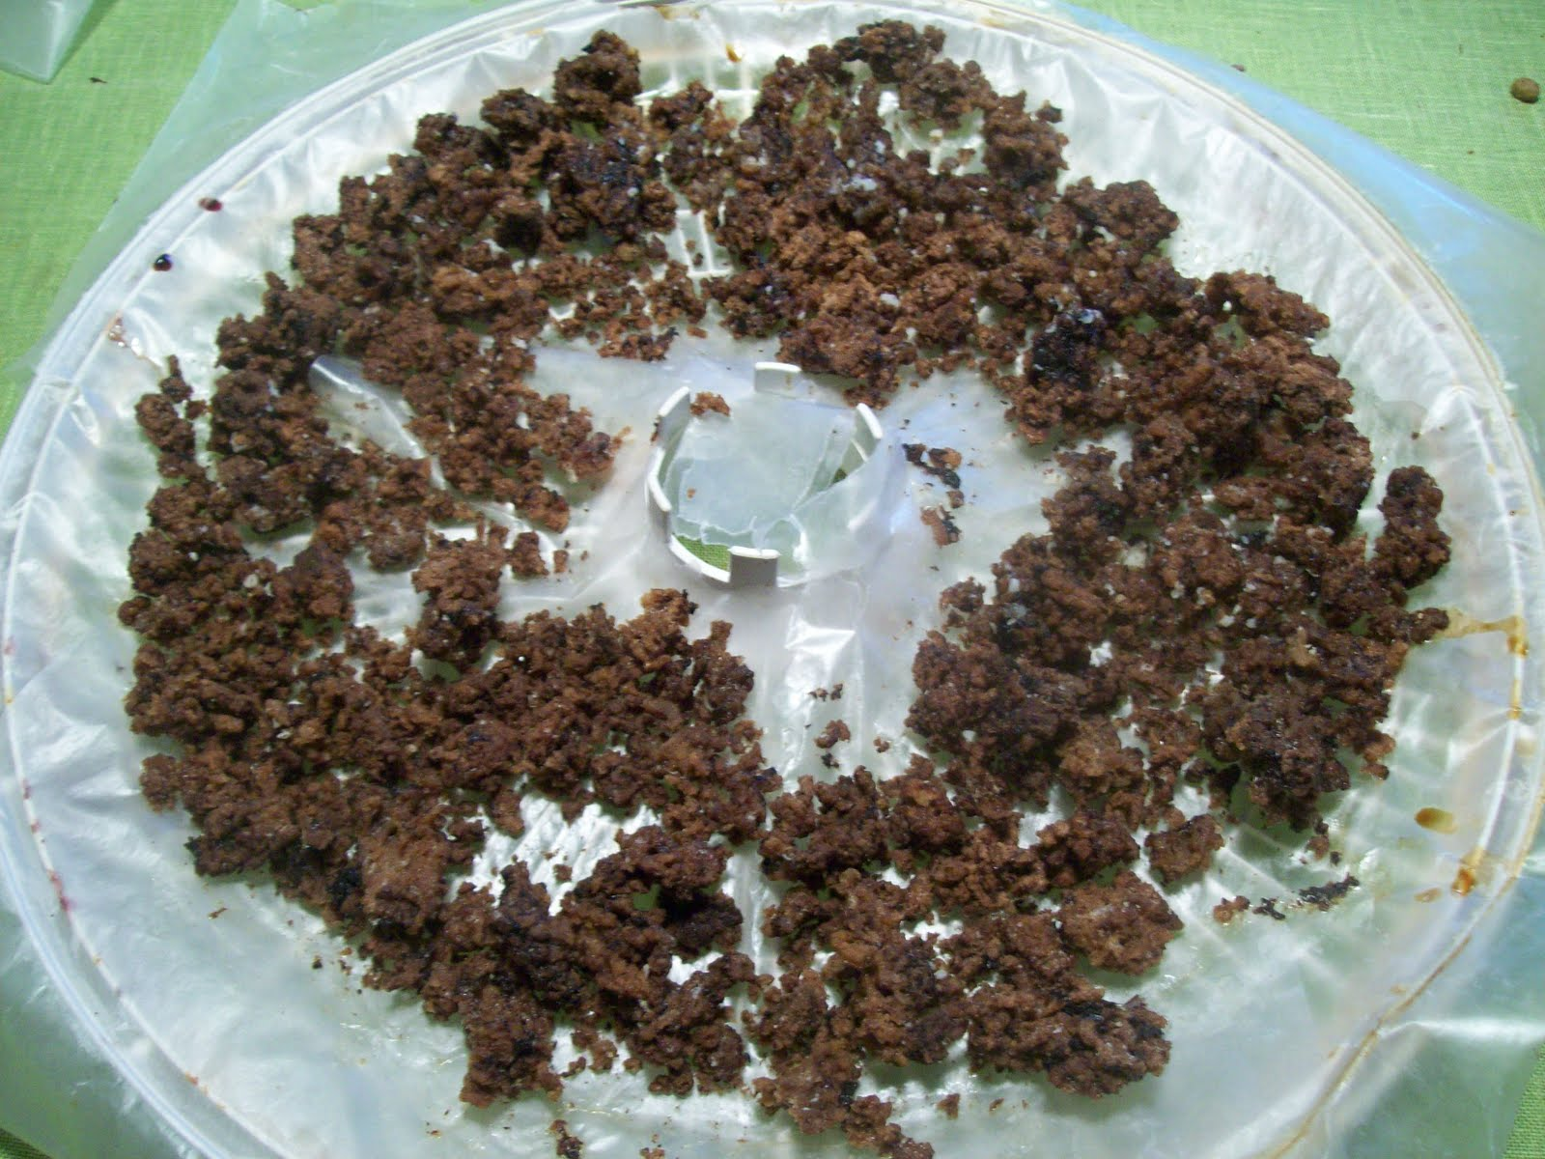
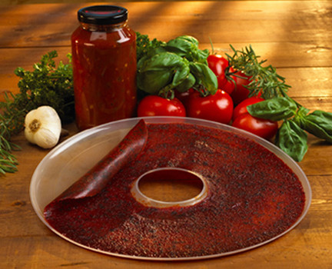
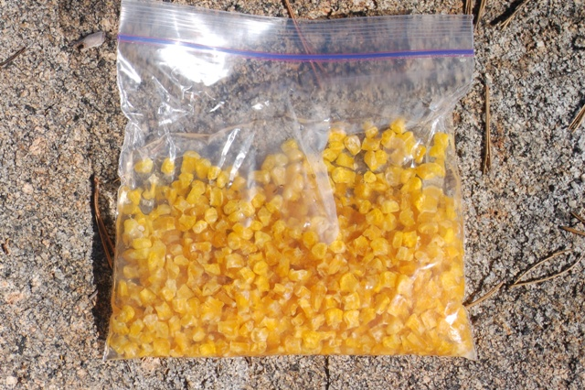
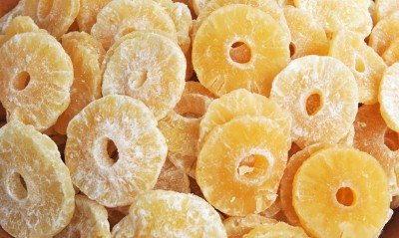
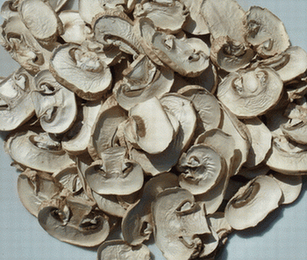
What can be dehydrated
Meat
Vegetables
Spaghetti Sauce
Fruits
In other words, most things can be dehydrated.

Slide 10
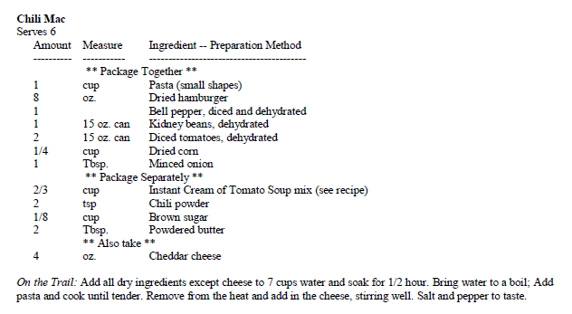
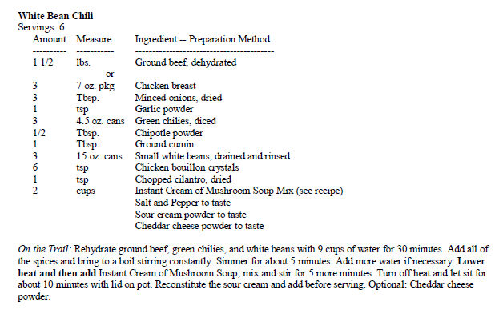
BACKPACKING RECIPES

Slide 11
http://bsa344.com/Cooking.html

Slide 12
Estimating Quantities
Use these guidelines to determine how much food you’ll need.
Where normal caloric requirements may be between approximately 2,000 and 2,800 Calories/day/person, the energy requirements for a strenuous or high adventure trip are 3,000 - 5,000 Calories/day/person and winter treks require 1,000 MORE Calories/day than summer treks.
This translates to about 2 - 2.5 lbs. of (lightweight) food per day per person
The menu should be nutritionally balanced at about 50% carbohydrates, 25% fats and 25% protein.

Slide 13
Nutrition
Carbohydrates are easily digested and release energy in minutes, but their energy is rapidly consumed.
During cold, wet weather it is important to continuously stoke up with carbohydrates and it is recommended that you eat lunch "from breakfast to dinner" or snack frequently on carbohydrates during the day.
Carbohydrates come from starches (potatoes, rice, pasta), cereals, fruit, nuts (trail mix or gorp!), honey and candy (esp. hard candy).

Slide 14
Nutrition
Protein is more difficult to digest and the energy boost takes longer to take effect.
High protein foods should be taken in small amounts during the day and concentrated at the evening meal so energy is available for "body repair" and generating body heat while you sleep.
Foods high in protein (other than meats) include instant milk, nuts, and cheese.

Slide 15
Nutrition
Fats produce energy that is consumed by the body over comparatively long periods and have over twice the energy of proteins.
Fats provide us with 9 calories per gram and are much more energy-rich, or energy-dense, than carbohydrates or proteins.
Carbohydrates and proteins provide us with 4 calories per gram.
Fats, like proteins, are harder to digest, so they should be consumed in small quantities during the day and most of the daily fat intake should be concentrated in the dinner menu.
Foods high in fats include peanut butter and cheese.

Slide 16
Packing Foods for Backpacking
Repackage ingredients and meals into Ziploc freezer bags which are more durable than regular bags. This will minimize space and weight. Cut off the instructions and include it with the meal ingredients. Ziploc bags can be re-used while on the trail to organize necessities, trash, or to keep items dry and clean.
Label each Ziploc bag. Write down the meal name, amount of water to add, simmer time, or any other specific cooking instructions. Write it on the bag itself, or on a small slip of paper that you can insert inside the bag.
Group all ingredients by meals and put into larger (gallon size) Ziploc bags.
Double bag powdered milk and other powdered drinks. You can put the instructions from the original packing between the bags.
Be careful not to over pack on food! Remember, we can survive several days without food, but drinking water is critical. If you run out of water, do not eat. Your body requires extra water to digest food. Plan 1.5 – 2 lbs. of total food (including snacks) per person per day.

Slide 17
Trail Baking Techniques
Have you ever wished you could have a hot biscuit or muffin in the morning but not carry a ton of weight or a huge pot? You can!
Smooth out a new windscreen and lay your kettle on top.
Trace the shape and then, using scissors, cut it out.
Trim it down a bit so that it will fit in your pot, about 1/4″ smaller than the inside of the pot.
You want it so you can drop it into the pot.

Slide 18
Trail Baking Techniques
Using a ruler trace a grid of 1/2″ squares on it.
Use a tiny Phillips head screwdriver or awl to do this by gently dragging the screwdriver or awl on the metal to leave a light line.
Find a scrap piece of wood to set your circle on top of.
Use the screwdriver or awl to punch a hole carefully at the intersection of each square on the grid and also in the center of each square.

Slide 19
Trail Baking Techniques
Cut another piece of the metal about 14″ long and 1″ wide (longer if it is for a pot bigger than the cup shown above).
This is what sits at the bottom of the pan, and is spiraled, to hold the circle up off of the bottom.

Slide 20
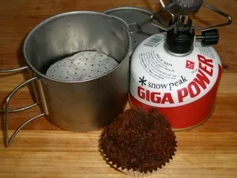
Trail Baking Techniques
When ready to start baking, put the spiral in the pan.
Put water in until it is almost to the top of the spiral and top with the circle.
Put the pan on your stove and bring it to a boil.
As soon it is boiling lower the stove heat to where it is barely burning, place your item to be baked on the disc, and put the lid on the pan.
Start the timer for 15 minutes. With the low amount of water in the pan it will continue to gently simmer/boil and conserve fuel use. When the time is up, turn the stove off and let it sit for 5 minutes.
Do not take the lid off of the pan while cooking items that raise (biscuits, cakes, etc.) as the cold air can cause the items to flop.
15 minutes seems perfect for cooking time, along with a 5 minute rest.
While the items don’t get browned, they will be perfectly cooked through, moist and tender as well!
The weight of the materials (not counting your pot) is less than 1/4 of an ounce.

Slide 21
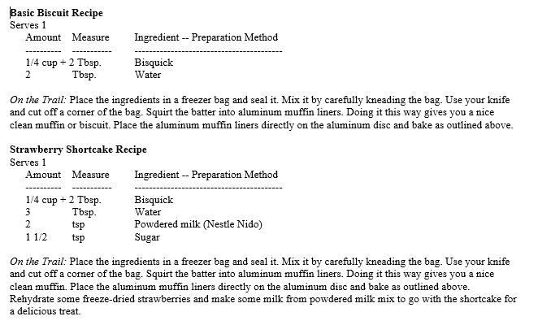
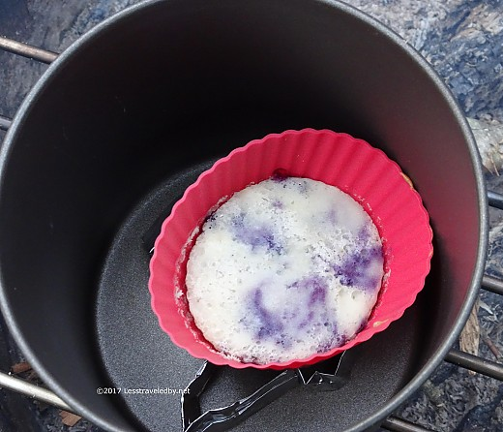
Trail Baking Techniques

Slide 22
Backpacking Stove Pot Support Stand
One of the main problems cooking with most backpacking stoves is the small base upon which the pot sets. If you are not careful, supper can slide off of the stove and spill on the ground. This is a real bummer at the end of a long hard day of hiking.
You can reduce this problem with extra support for the pot with a pot stand cut out of 1/2" x 1/2" hardware cloth. Hardware cloth is strong enough to support a pot, but weighs next to nothing.
The following instructions are for a MSR Whisperlite stove (older model). Please check that it works with your model. This design can be modified to work with many other stoves.
Whisperlite stove and 1/2" x 1/2" hardware cloth pot support shown without windscreen

Slide 23
Backpacking Stove Pot Support Stand
Tools and Supplies Needed:
Wire cutters
Coarse sand paper or metal file to smooth wire ends
Scissors
1/2" x 1/2" hardware cloth (sold in hardware stores)
Aluminum windscreen material or aluminum pie pan
½ inch hardware cloth

Slide 24
Backpacking Stove Pot Support Stand
Cut the hardware cloth to the desired height and length for your pots and stove with the wire cutters.
For older model Whisperlite Stoves, cut a strip of 1/2" x 1/2" hardware cloth 7 squares high by 44 squares long.
This size works well to keep the pot close enough to the stove for good heat transfer.
You will also be able to nest the pot support inside of your pot when packing.
File or sand the cut ends to smooth them out.

Slide 25
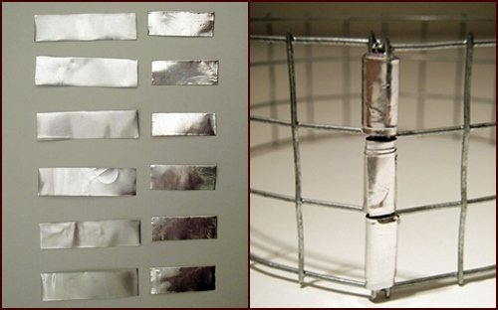
Backpacking Stove Pot Support Stand
Using an aluminum windscreen or aluminum pie pan and scissors, cut seven 1” x 3/8” strips.
Bend the hardware cloth into a circle and fasten the ends together by wrapping the 1” x 3/8” strips of aluminum windscreen material around the corresponding wires.
Wrap the aluminum strips tightly around both wires until it is all used.
The eraser end of a pencil is useful for pushing the aluminum strips through the squares.
Now you have a flexible but strong joint holding your pot support together.
Aluminum strips wrapped tightly around the ends makes a strong hinge.

Slide 26
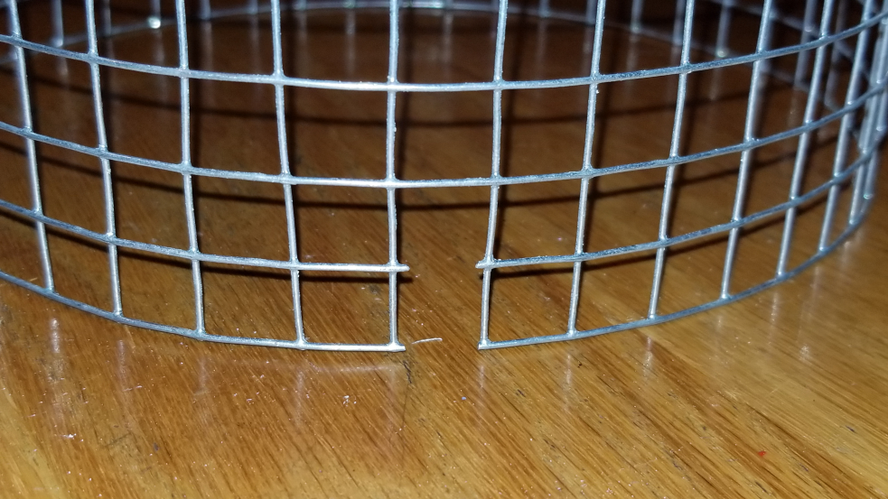
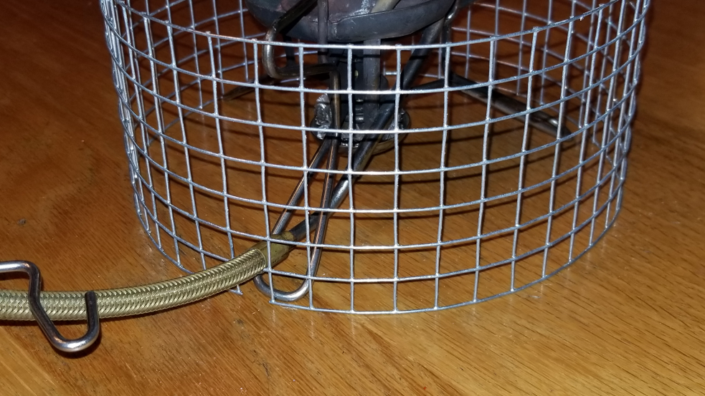
Backpacking Stove Pot Support Stand
With the wire cutters, cut a notch in the bottom of the pot stand to allow the Whisperlite stove fuel line to pass through.
Fuel line notch
Whisperlite fuel line passing through the notch in the pot stand.

Slide 27
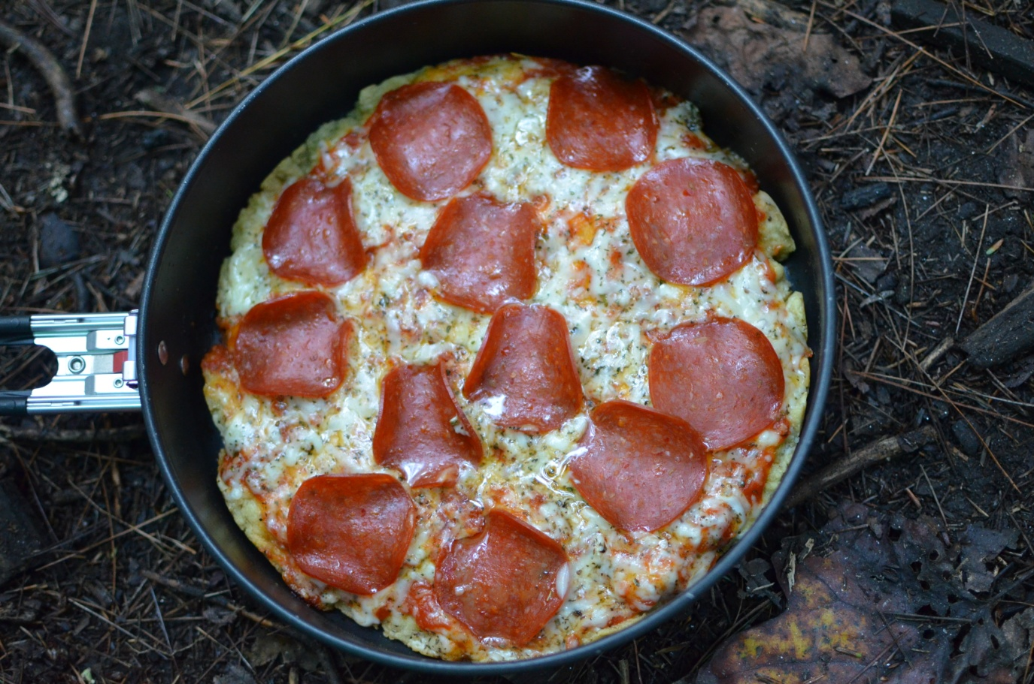
Let’s Eat!

